Slide 1
Market Design and Performance of the Northeastern ISO Markets
Udi Helman
Division of the Chief Economic Advisor,
Office of Markets, Tariffs and Rates, FERC
NEMS/AEO Conference, Washington, DC, March 27, 2001
The views presented here do not necessarily reflect those of other FERC staff nor the official positions of the Commission. All market information used in this presentation is publically available. The author can be contacted at udi.helman@ferc.fed.us.

Slide 2
0.1 Themes
Design and implementation of ISO spot markets still in progress: significant achievements but remaining problems
Increasing understanding of market needs and incentives with concomitant changes in market design
Convergence in market design among northeastern ISOs; further coordination and possible integration of the Northeastern markets under discussion
Market performance varies by ISO and product. This presentation will not address market monitoring and market power mitigation.

Slide 3
0.2 Outline of Presentation
0. Background
1. Unit commitment, scheduling and dispatch process
2. Energy markets
3. Ancillary service and ICAP markets
4. Congestion pricing, transmission rights and management of interties
5. Market interactions
6. The market design agenda for the next few years (design changes, inter-regional coordination and integration, RTOs); comparison with California

Slide 4
0.3 “Voluntary Poolco” ISO Markets
1. Voluntary centralized spot markets
~ price and quantity bids
~ Day-ahead Market (DAM), typically > 90% spot volume; Real-time Market (RTM), typically < 10%
2. Bilateral transactions
~ request for transmission service: quantity, point of injection (POI) and point of withdrawal (POW)
3. Self-schedules
~ quantity request (will take locational or system price)

Slide 5
0.4 Components of Market Design
unit commitment, scheduling and dispatch procedures of centralized (spot) auction
number and type of bid-based products
rules for bidding and price determination (auction)
settlement system
congestion management system
transmission rights primary auctions/allocations and secondary markets
coordination with other regional markets (interties, reserves, emergency procedures)

Slide 6
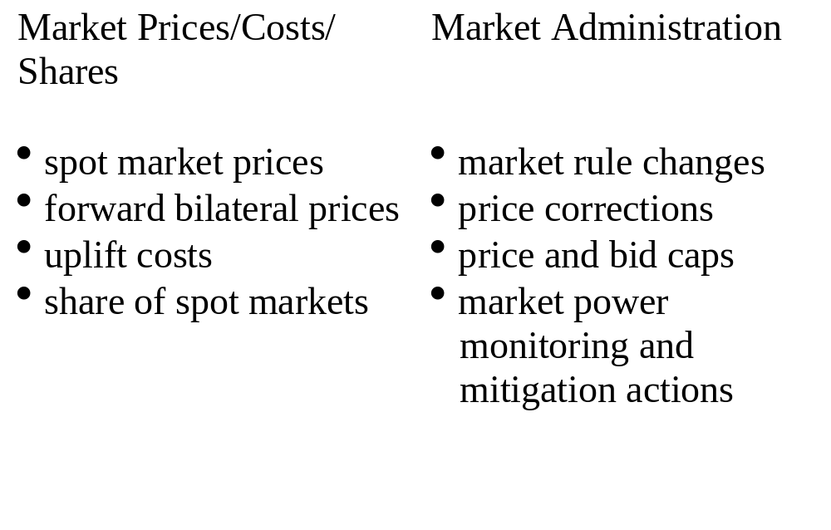
0.5 Indicators of Wholesale Spot Market
Performance

Slide 7
0.6 Market Design Principles
Economic efficiency
Maintain reliability
Low transactions costs/ease of participation
Flexibility/choice
Market completeness
Minimize opportunities for exercise of market power

Slide 8
1.1 Unit Commitment, Scheduling and
Dispatch
Unit commitment: centralized optimization program which determines least-cost commitment of generation to meet forecast load based on submitted bids, subject to reliability and intertemporal constraints
Schedule: forecast hourly dispatch levels for internal/external transactions. Updated frequently prior to real-time
Dispatch: minute-to-minute levels of generator output/dispatchable load and adjustments of external transactions to meet actual load

Slide 9
1.2 Day-Ahead Unit Commitment and
Scheduling
All three ISOs run Security Constrained Unit Commitment (SCUC) programs day-ahead to set hourly prices and schedules for the next 24 hours (New England currently just to set the schedule)
The steps in the SCUC program differ depending on each ISO’s reliablility requirements, market power monitoring and mitigation procedures, etc.

Slide 10
1.3 Changes to the Schedule prior to
Dispatch
PJM: Changes to schedule based on changes in unit availability, new transactions
New York operates a Balancing Market Evaluation (BME) 90 minutes prior to dispatch hour to establish advisory prices and schedule (but not financial settlement)
~ significant problems over 2000 in New York due to lack of correlation between BME and Dispatch prices; improvements since then

Slide 11
1.4 Dispatch
An important issue is how real-time prices are calculated during dispatch:
~ PJM has a 30 minute “look-ahead” during real-time operations; gives system operator more discretion to dispatch generation efficiently and smooths real-time prices
~ New York and New England currently have a 5 minute look-ahead; less system operator discretion, but more real-time price volatility

Slide 12
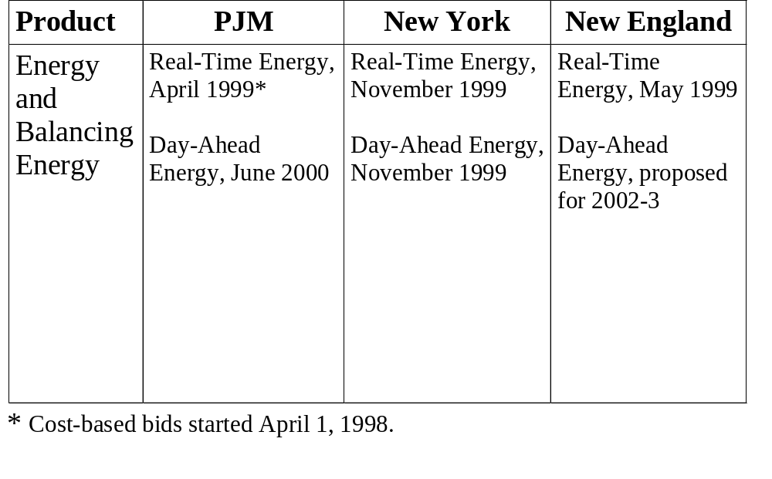
2.1 Bid-Based Energy Markets

Slide 13
2.2 Day-Ahead Energy Bid Rules
(PJM, New York and proposed New England)
Three part supply bids (start-up, no load, and incremental energy), demand bids, virtual bids
Technical parameters for generators: low/high operating level, minimum run, ramp rate, etc.
Bid sufficiency guarantee
Bid restrictions (market power mitigation)
~ limitations on changes in start-up, no-load bid price (PJM, 6 months)
~ limitations on changes in technical parameters

Slide 14
2.3 Real-Time Energy Bid Rules
(PJM, New York and proposed New England)
Rebidding after DAM:
~ PJM currently allows rebidding between 4-6 pm prior to the start of the operating day
~ New England will allow rebidding up to 90 minutes prior to dispatch hour
~ New York BME is 90 minutes prior to dispatch hour

Slide 15
2.3 (cont.) Real-Time Energy Bid Rules
(PJM, New York and proposed New England)
Bid restrictions
~ can re-bid MWs accepted into DAM only at lower price (New York, New England)
~ cannot change prices on MWs accepted into DAM (PJM)

Slide 16
2.4 How Energy Prices are Determined
In absence of congestion, uniform clearing prices in all ISO markets, based on next MW available to serve load; when congested, locational marginal prices (forthcoming in New England)
“Pay-as-bid” components (when bids not covered by energy market revenues, as affected by bids for start-up and no-load, ramp rates, min run times)
Energy bid/price caps ($1000/MWh) in all three markets (limited to capacity deficiencies in New England; renewal pending in New York and New England)

Slide 17
2.5 Virtual Bidding
Virtual bidding. A virtual bid is a financial bid into the DAM that is not necessarily associated with actual supply or demand; provides greater financial flexibility. Status: implemented in PJM, in development in New York, planned in New England (demand only)
PJM currently has approx. 10,000 MW/day each in virtual demand and supply bidding, mostly at PJM Western hub

Slide 18
2.6 Bilateral Markets
Trading hubs: PJM West is most liquid hub; New York and New England have yet to develop hubs
No separate bilateral power exchanges currently operating in northeastern markets
~ FERC has supported rule changes to (some) ISO markets that would assist in formation of such exchanges: e.g., self-scheduling of energy and ancillary services; no involuntary exposure to uplift costs (e.g., due to start-up costs) associated with ISO energy or ancillary service markets

Slide 19
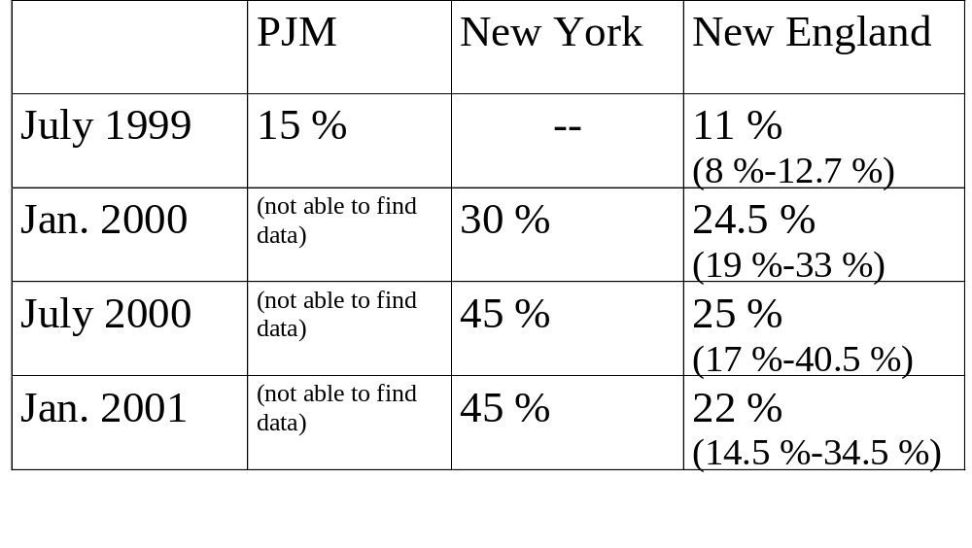
2.7 Relative Share of Energy Spot Market
(average followed by range, if available; the remainder is self-schedules and/or bilateral transactions)
Note: These are figures as reported by the ISOs. However, differences in how energy transactions are recorded will affect these data. For example, in New York, for the period examined, there were no “self-schedules;” hence, what might be recorded in PJM as a self-schedule could be recorded in New York as a spot market transaction.

Slide 20
2.8 Spot Energy Markets Performance
Price spikes: PJM, July 1999; New England, May 2000; New York East, June 2000
Modifications of bidding rules for energy limited generators (New England, New York) and CTs dispatched in fixed blocks (New York)
Manipulation of supply bid technical parameters (e.g. minimum run) and consequent rule changes (PJM, New England)
Volatility in real-time prices (New York, New England)

Slide 21
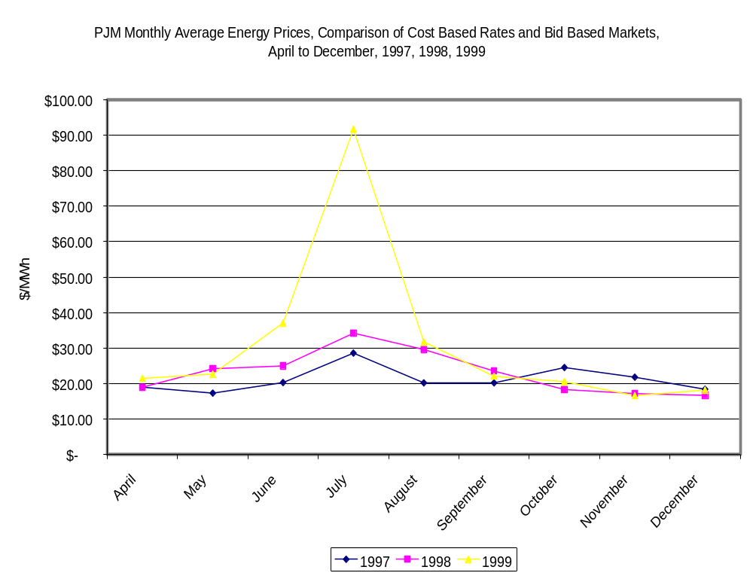

Slide 22
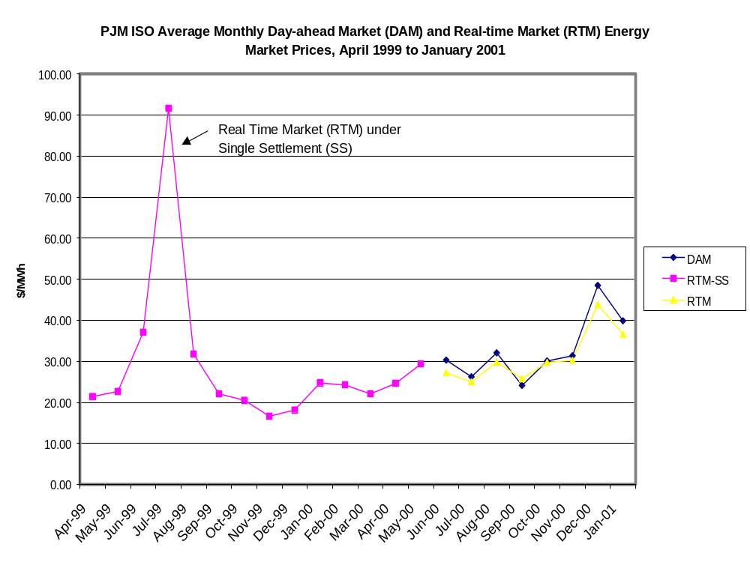

Slide 23
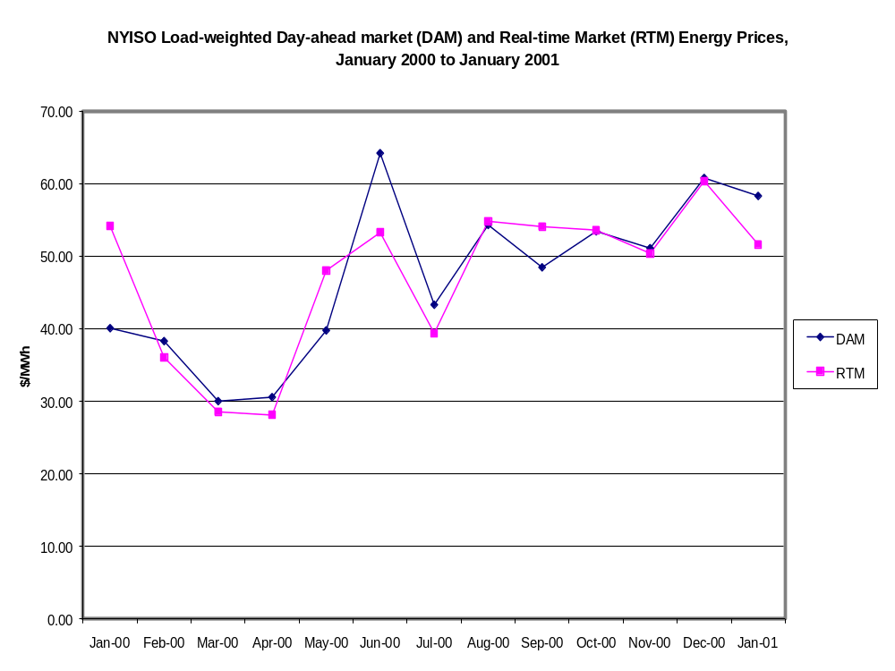

Slide 24
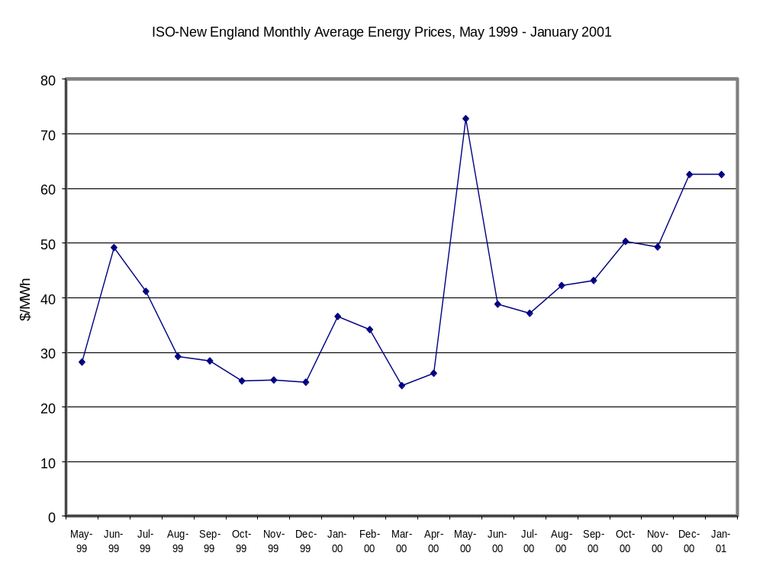

Slide 25
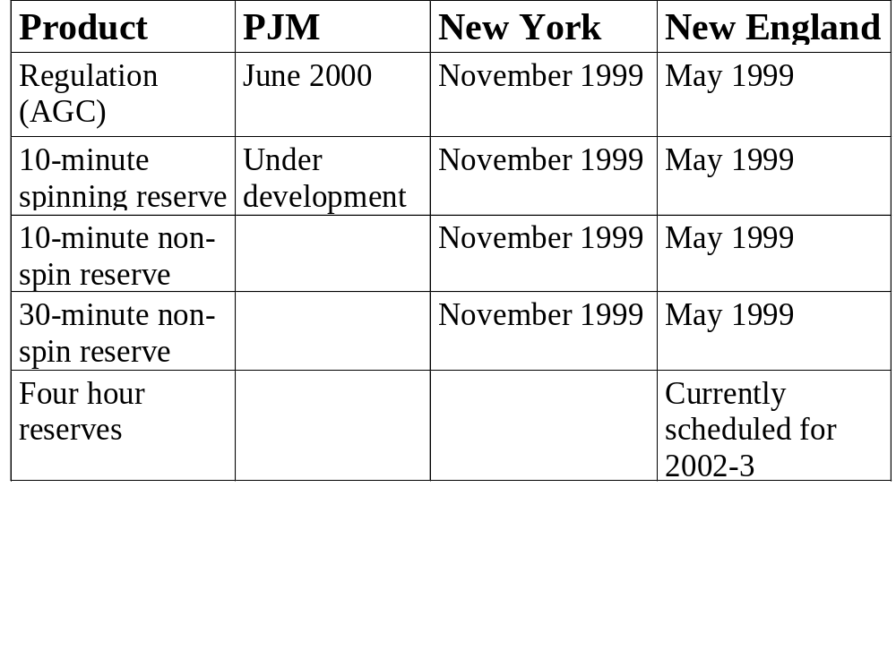
3.1 Bid-Based Ancillary Services
Markets

Slide 26
3.2 Ancillary Services Market Rules
(PJM, New York and proposed New England)
Availability bids and opportunity cost payments for all bid-based ancillary services
Simultaneous or cascading clearing of ancillary service bids
Uniform clearing price in each market or zone (New York)
Current New England rules: complex bid ranking and price setting rules which will be simplified under the forthcoming market redesign

Slide 27
3.3 Ancillary Services Markets
Performance: New York
Exercise of market power in ten-minute reserve markets in early 2000
Bid cap on ten-minute non-spinning reserves ($2.52/MW)
Operating reserve prices (monthly average) fall under $5 by April 2000
Regulation prices fall after initial highs

Slide 28
3.3 (cont.) Ancillary Services Markets
Performance: New England
Spikes in ancillary service prices in summer of 1999 and around May 2000
Ancillary service prices temporarily capped by energy price to prevent price inversions
From July 2000, operating reserve prices and quantities collapse as reserves are increasingly covered by generation paid through energy uplift market (in part to provide unpriced replacement reserves)
AGC market prices and volumes stable

Slide 29
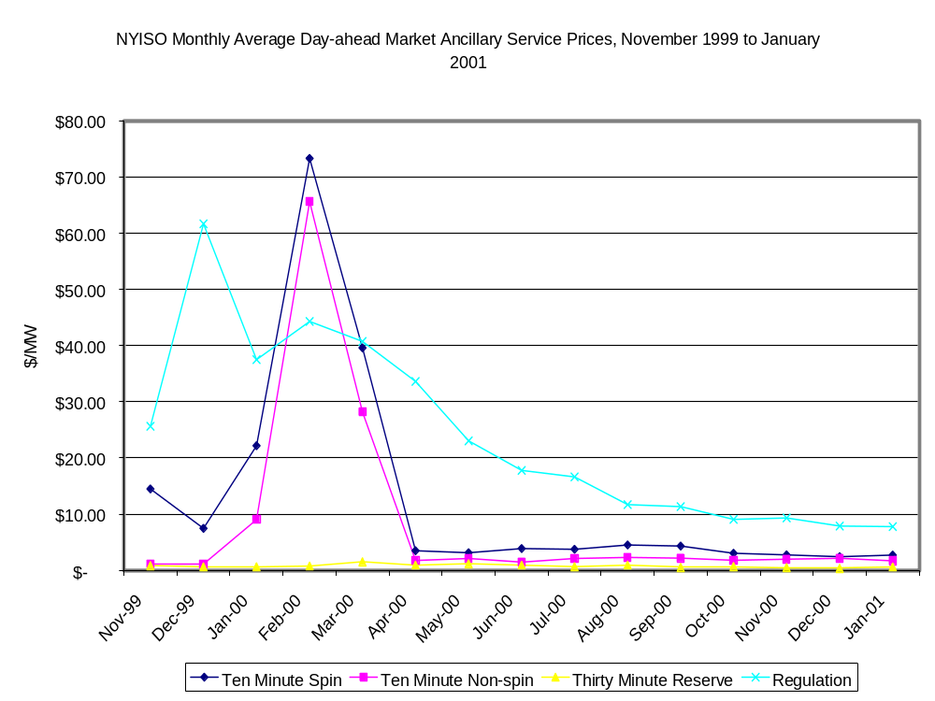

Slide 30
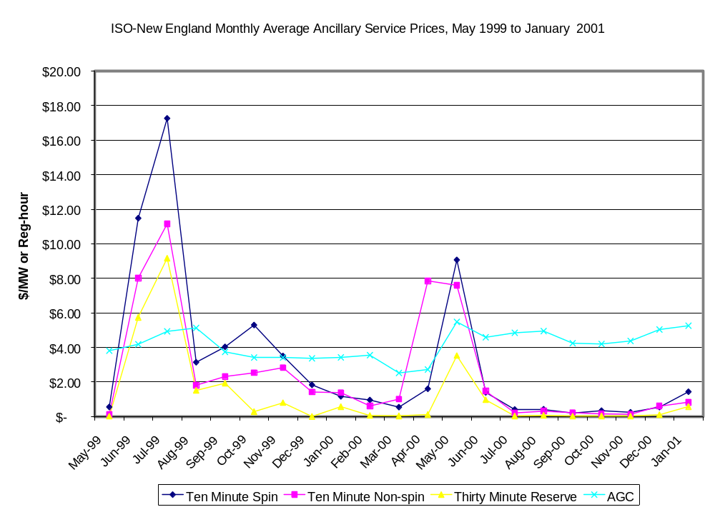

Slide 31
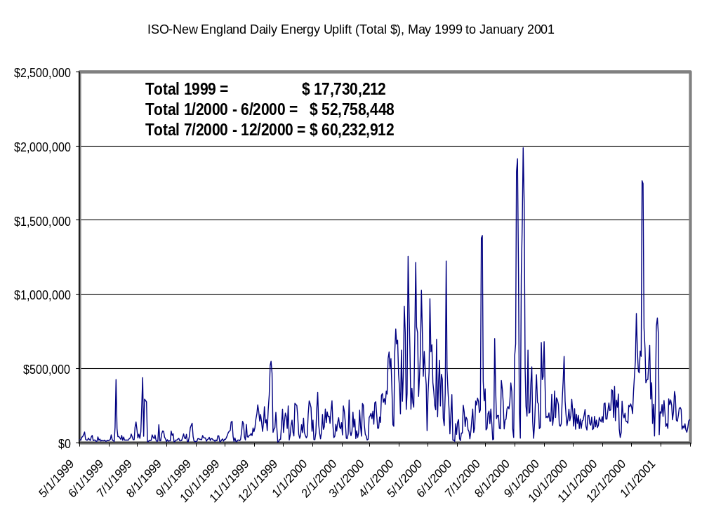

Slide 32
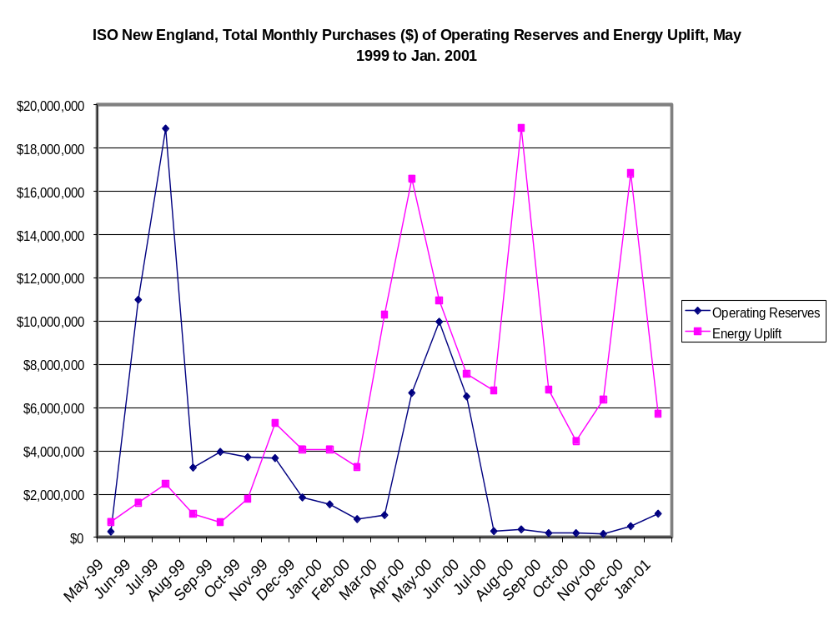

Slide 33
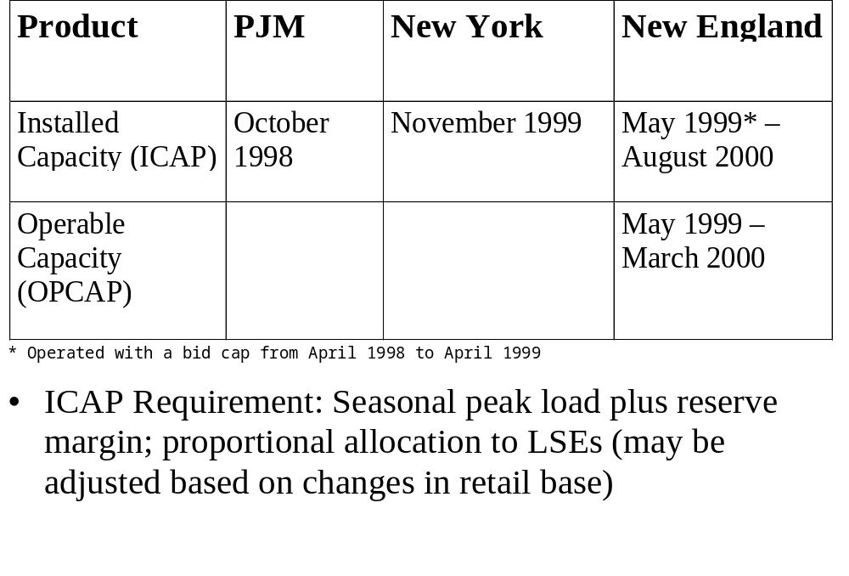
3.4 Bid-Based Capacity Markets

Slide 34
3.5 Installed Capacity Market Rules:
PJM
Daily and monthly auction for capacity credits
Mandatory sell (buy) for generators (load) with excess (deficiency)
Capacity deficiency rate = $177.30/MW/day
Energy exported by a capacity resource must be recallable in event of capacity deficiency; ICAP resources can delist with 2 day notice; penalty for disobeying ISO recall of energy

Slide 35
3.5 (cont.) Installed Capacity Market Rules:
New York
Monthly and six-monthly auction for three zones: NYC, Long Island, and rest of NY
ICAP resources must bid into DAM
ICAP supplier must submit recall bid when exporting; paid higher of LMP or recall bid
Locational deficiency charge (increasing over time)

Slide 36
3.5 (cont.) Installed Capacity Market Rules:
New England
Monthly auction of residual ICAP
Seasonal ICAP availability requirement
ICAP status not tied to ISO recall of exports during capacity deficiencies; rather all New England generation resources, regardless of being ICAP, are recallable

Slide 37
3.6 Installed Capacity Market Performance
PJM: In 2000, problems with pivotal ICAP bidder and submission of imbalanced demand and supply bids designed to raise prices; market clearing price set at $177 since January 1, 2001; market rule changes pending
New England: Severe bidding problems begin in 2000 resulting in high prices and market power mitigation steps; FERC terminates ICAP auction (August 2000), but not ICAP requirement, and also requires ICAP deficiency penalty; level of deficiency penalty subject to much dispute

Slide 38
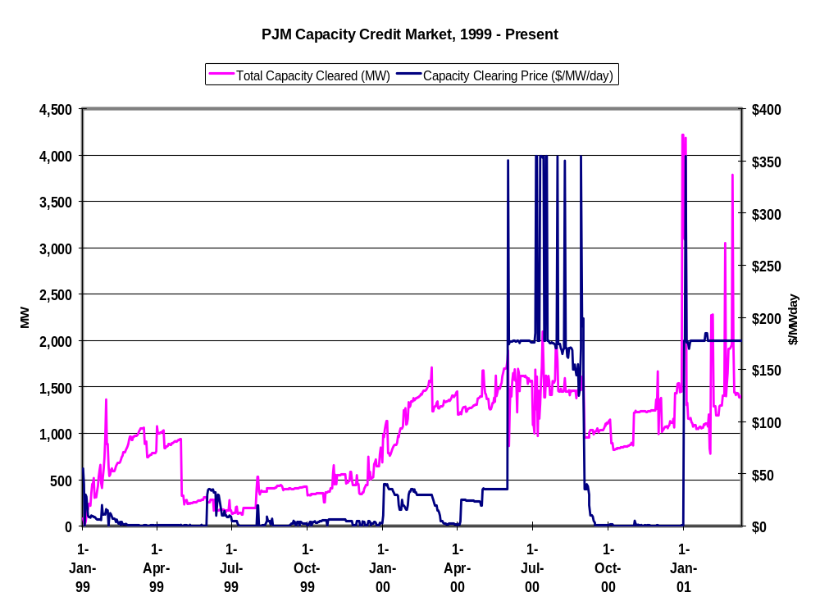

Slide 39
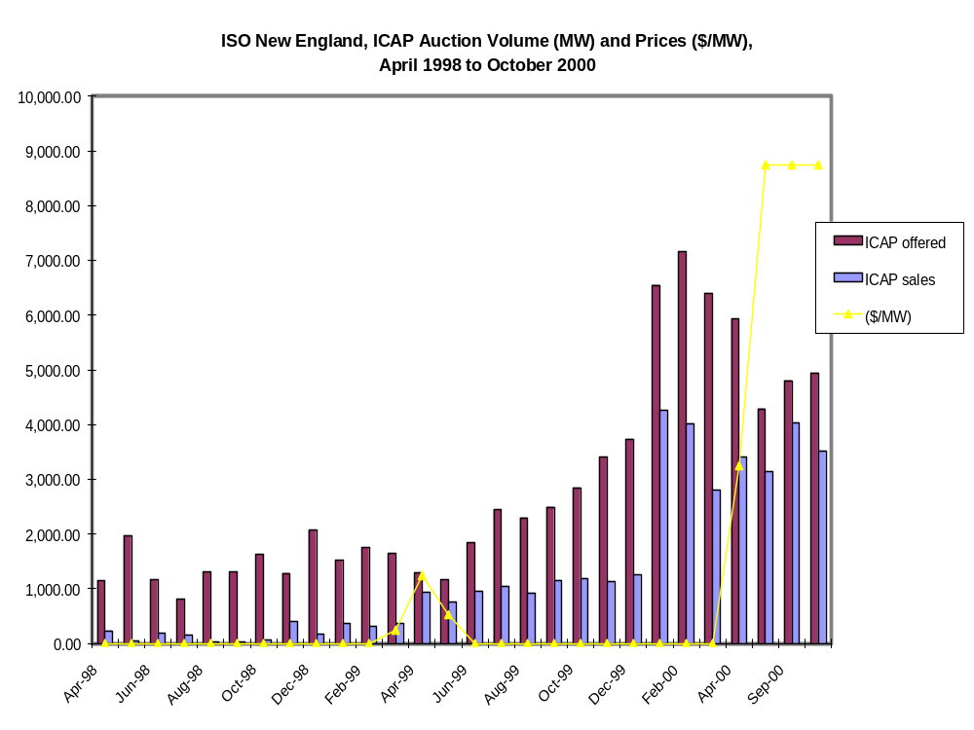

Slide 40
4.1 Congestion Pricing
Locational marginal pricing (LMP) of congestion in PJM and New York; congestion cost is the difference between price at point of injection (POI) and point of withdrawal (POW)
nodal price to generation; zonal price to load (New York; proposed New England)
In current New England system, congestion costs due to re-dispatch are allocated on a pro-rata basis; future congestion management system based on LMP

Slide 41
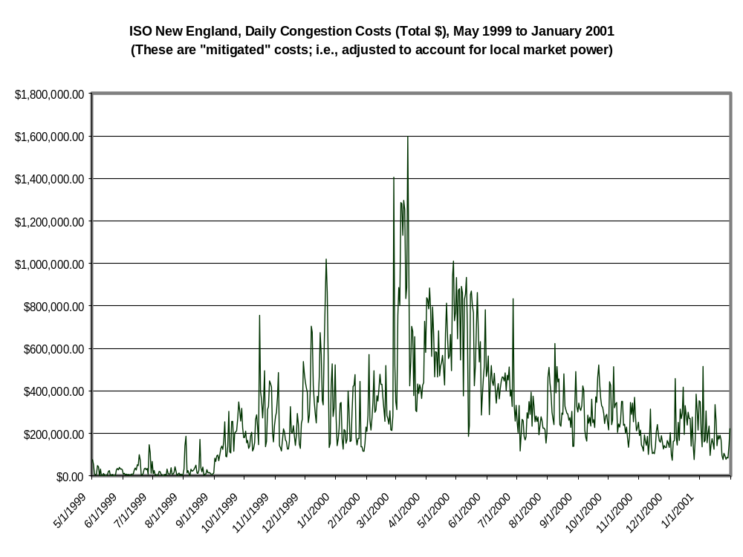

Slide 42
4.2 Financial Transmission Rights
All transmission users have physical right to use the transmission grid if they are willing to pay congestion costs (few, if any, TLRs in ISO markets)
Point-to-point financial transmission rights as obligations in PJM (FTRs), New York (TCCs) and forthcoming in New England (FCRs)
Can be configured between hubs, zones and nodes
Monthly and semi-annual primary auctions becoming quite liquid (PJM); secondary markets not very active

Slide 43
4.3 Recent and Forthcoming Develop- ments in Transmission Markets
Transmission congestion bidding: request for transmission service with an upper bound on congestion costs; currently implemented in PJM with a $25 cap on the congestion bid; encouraged by FERC in New York and New England
Financial point-to-point rights as options; encouraged by FERC, under evaluation in the ISOs
Flowgate rights: under discussion in other markets, could be considered in the northeastern markets

Slide 44
4.4 Scheduling on Interties
Differences in how schedules over interties are set (New York uses bid prices; New England and PJM use reservations) and the deadline for receiving changes (PJM 20 minutes, New York 90 minutes)
Limitations on how fast schedules can change due to internal ramping constraints; some effort to improve flexibility and coordinate procedures among ISOs

Slide 45
4.4 (cont.) Scheduling on Interties
Complaints about external transactions being cut at New York border due to effects of BME
~ corrective rules: “sham” transactions pay NY real-time price; external transactions paid BME price when there is congestion on intertie
New York complaint that physical reservation of New England and PJM interties and New England rules for short-term external transactions are causing “counter-intuitive” use of interties and physical withholding of capacity (New England)

Slide 46
5.1 Market Interactions
Market experience has revealed unexpected interactions between market prices for different products due to market designs and solution algorithms: between ancillary services; between energy and ancillary services; and between energy and ICAP
Market experience has revealed unexpected interactions between regional markets due to differences in market rules, emergency procedures, and so on

Slide 47
5.2 Market Interaction Example 1:
Energy and ICAP in PJM
ICAP payments in PJM are intended to provide sufficient revenue to generators to provide the ISO with the option to recall exports during tight capacity periods
However, penalties for having insufficient ICAP may not be sufficient to keep generation in PJM
Market analysis of summer 1999 suggests that generation stayed in PJM due to high internal energy prices which resulted from market power rather than threat of ICAP penalties (see PJM Market Monitoring report for 1999)

Slide 48
5.3 Market Interaction Example 2: The
May 8, 2000 Price Spike in New England
On May 8, 2000, ISO New England declared a capacity deficiency condition due to unseasonably high temperatures and unplanned outages
Reliability rules required the ISO to use, if available, energy that did not degrade the internal reserve margin
A standing dispatchable external bid on the border with New York offering ICAP bundled with $6000 energy was dispatched for 4 hours and set the energy market clearing price

Slide 49
6.1 Key Market Design Issues 2001-2:
PJM
Extension of PJM market to PJM West
Changes in ICAP market (address strategic bidding problems) (pending at FERC)
Changes in FTR allocation (approved by FERC)
Bid-based spinning reserve market under discussion
Price-responsive load management programs

Slide 50
6.2 Key Market Design Issues 2001-2:
New York
Improvements in operating reserve markets: reservation of transmission for locational reserves; modification of software to accept bids from additional generation that can provide reserves (e.g., hydro)
Modification of software to price fixed block CTs efficiently (becoming pay-as-bid)
Virtual bidding under development
Price-responsive load management programs

Slide 51
6.3 Key Market Design Issues 2001-2:
New England
Implementation of Congestion Management System (CMS)/Multi-Settlement System (MSS)
~ Proposed Implementation Schedule: Phase 1 would be basically existing single-settlement system with LMP; Phase 2 would introduce day-ahead markets. Issues: length of schedule; inter-regional coordination (pending at FERC)
Interim uplift costs
Price-responsive load management programs

Slide 52
6.4 Inter-Regional ISO Market Issues
2001-2: MOU
Memorandum of Understanding among PJM, New York, New England and Ontario: addresses numerous business practice, market design and operational issues as a means to break down market barriers. Some recent developments:
~ project to develop inter-regional coordination of Real-time Energy Market
~ New York-New England reserve sharing agreement will allow reduction in reserve margin by 300 MW

Slide 53
6.5 Inter-Regional ISO Market Issues
2001-2: DAM Feasibility Study
Feasibility study for combined Day-ahead Market (DAM) undertaken by New York, New England and Ontario; final report in May 2001.
~ Options: sequential unit commitment with separate DAMs; hierarchical unit commitment imposed on separate DAMs; single unit commitment for entire region
~ Next phase, if undertaken, would involve market modeling and cost-benefit analysis

Slide 54
6.6 RTO filings by ISOs
All three ISOs have submitted RTO filings
All three request that RTO scope is co-extensive with current ISO boundary; PJM has filed for inclusion of PJM West
No major market design changes associated with RTO filings (transco proposal in New England)
FERC decision on RTO filings pending; some Commissioners have expressed desire for one RTO in the Northeastern US

Slide 55
6.7 Northeastern ISO Market Design Compared with California
Differences:
~ reasonably well functioning (and unrestricted) bilateral forward markets
~ more efficient spot markets (integrated ISO/PX)
Similarities:
~ differences in market design between ISO markets and adjoining markets
~ price caps, although much higher, could create inter-regional market distortions
~ minimal (but growing) demand-side price responsiveness

